Slide 1
Service Oriented Architecture
Prof Chandrahsekar Ramanathan

Slide 2
Outline
Background
Centralized vs Distributed Processing
Data Interchange Options
What is SOA?
Implementation Approaches
SOAP
REST

Slide 3
Centralized vs Distributed Processing
Centralized
Application is divided into one or more modules
Module implements one or more use cases
Business process invokes one or more functions
Distributed
Application is an aggregation one of more business processes
Each business utilizes the services of one or more functions

Slide 4
Data Interchange Options
With-in the same application
Function arguments
With-in the same server
Shared memory
Across the servers
Data files
HTTP data
Remote procedure calls
Centralized
Distributed

Slide 5
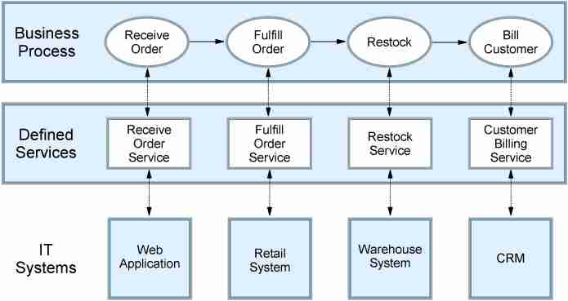
Traditional Enterprise Application Arch
Key Characteristics (Batch files)
Asynchronous
Batch Oriented
Difficulty to reuse / repurpose

Slide 6
Service Oriented Architecture

Slide 7
SOA Characteristics
Functionality divided into composable services (and not single use “local” functions)
Loose coupling between service provider and service consumer
Serves as building blocks for more complex services
Make business processes more dynamic
So what?

Slide 8
Key Elements of SOA
Open Standards
Integration points
Virtualization (location, platform, service provider)
Automation (business process vs workflow)

Slide 9
Definition of a “Service”
Services encapsulate a reusable business function
Services are defined by explicit, implementation−independent interfaces
Services are invoked through communication protocols that stress location transparency and interoperability

Slide 10
Service Granularity
Technical Function Services (for example auditEvent, checkUserPassword, and checkUserAuthorization)
Business Function Services (for example calculateDollarValueFromYen and getStockPrice)
Business Transaction Services (for example checkOrderAvailability and createBillingRecord)
Business Process Services (for example openAccount, createStockOrder, reconcileAccount, and renewPolicy)

Slide 11
SOA using Web Services
Web Service is an open-standards based protocol for implementing SOA over the web
Web services provide an open−standard and machine−readable model for creating explicit, implementation−independent descriptions of service interfaces.
Web services provide communication mechanisms that are location−transparent and interoperable.
Key Standards
TCP/IP, XML, HTTP
WSDL, SOAP, UDDI

Slide 12
SOA using REST
REST stands REpresentational State Transfer
Light weight alternative to SOAP-based Web Services
Key behavior characteristics
Stateless, Idempotent or Non-Idempotent, RO/RW
Key protocols
HTTP based methods such as GET, POST, PUT, DELETE
JAX-RS for Java implementations

Slide 13
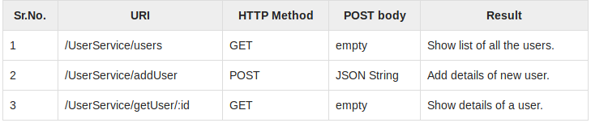
RESTful Services Example

Slide 14
Summary
SOA provides a powerful paradigm, especially for Enterprise Applications
SOA is not a technology but an architecture style
SOA can be implemented using either SOAP-based services or RESTful services

